Slide 1

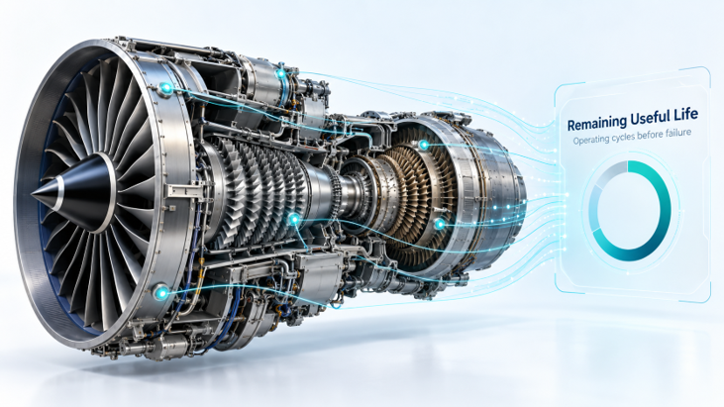
Aircraft Engine
Remaining Useful Life Prediction
NASA C-MAPSS FD001
Zainab Alshingiti

Slide 2
Table of Contents
The problem
1
The Models
5
The Workflow
2
Streamlit App
6
The Dataset
3
Conclusion
7
EDA
4

Slide 3
The problem
2023
Goal: estimate remaining operating cycles before engine failure.
Training data: 20,631 rows from 100 engine trajectories.
Inputs: cycle, 3 operating settings and 21 sensor channels.
RUL = final training cycle − current cycle.
Example: Engine 1 at cycle 1 has RUL = 192 − 1 = 191.
CYCLE
3
PERATING SETTINGS
21
SENSOR CHANNELS
3

Slide 4
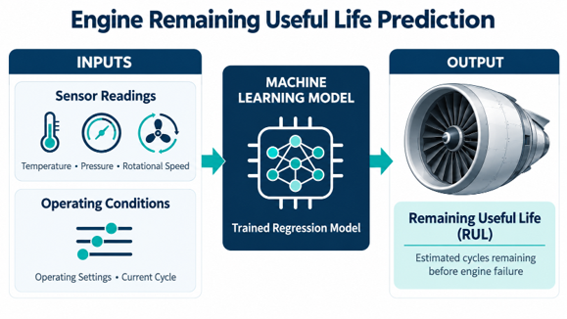
The Workflow

Slide 5
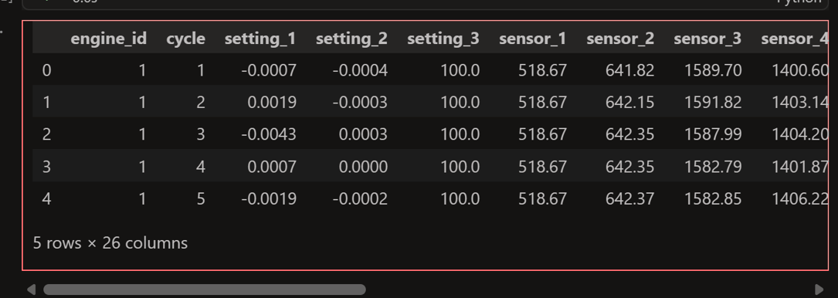
The Dataset
NASA C-MAPSS DATASET
Simulated aircraft engine data containing engine IDs, operating cycles, 3 operating settings, and 21 sensor readings. Each row represents one engine at one cycle, used to predict Remaining Useful Life (RUL).
4

Slide 6
The EDA
INITIAL EXPLORING DATA
EDA VISUALIZING
DECISIONS
6

Slide 7
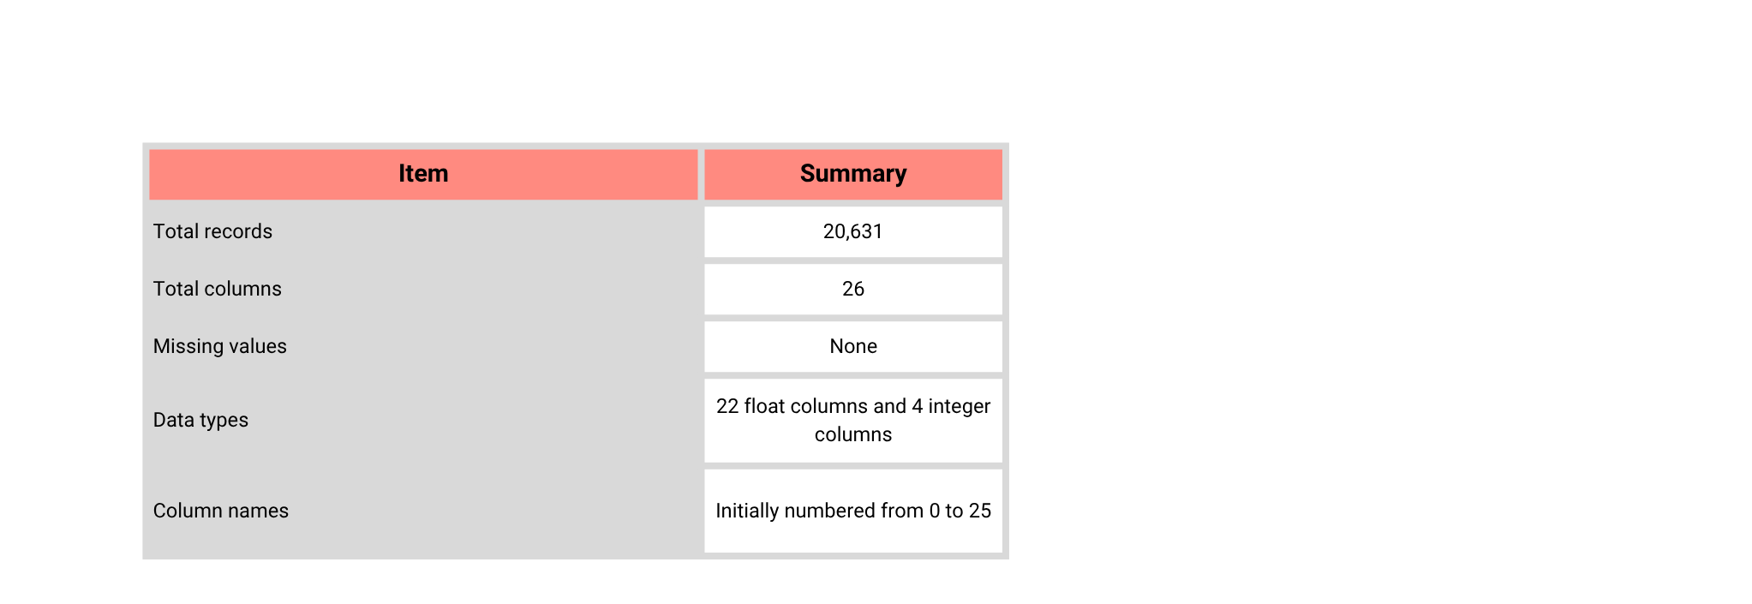
Initial Exploring Data
7

Slide 8
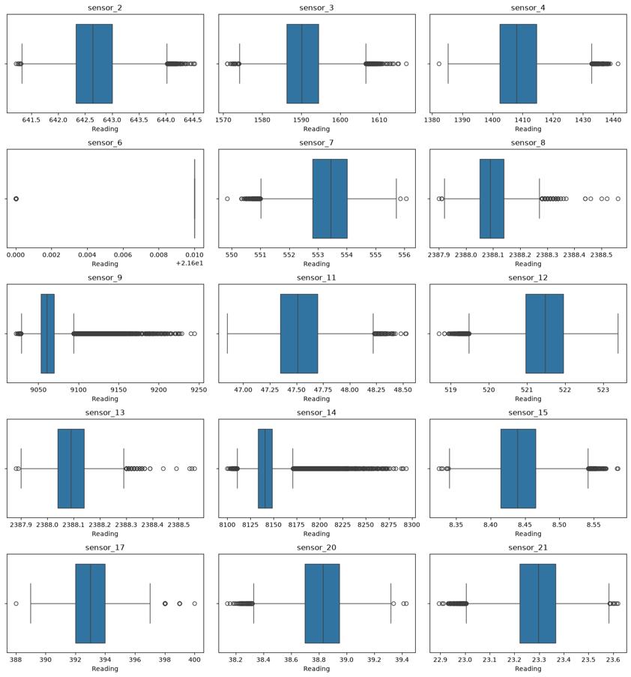
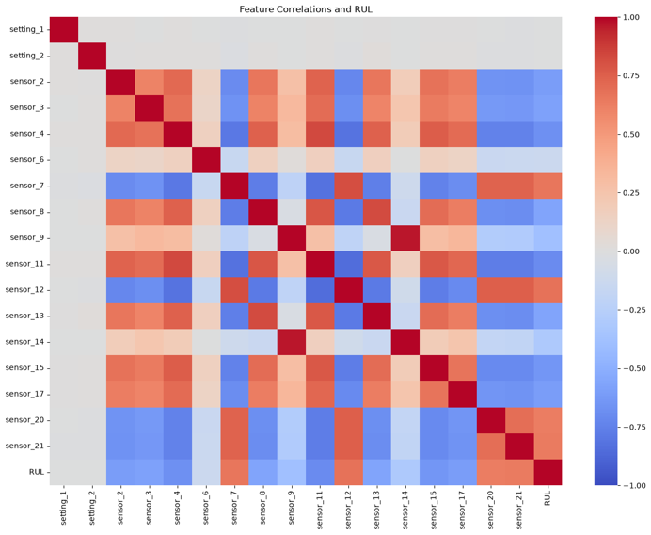
EDA visualizing
7

Slide 9
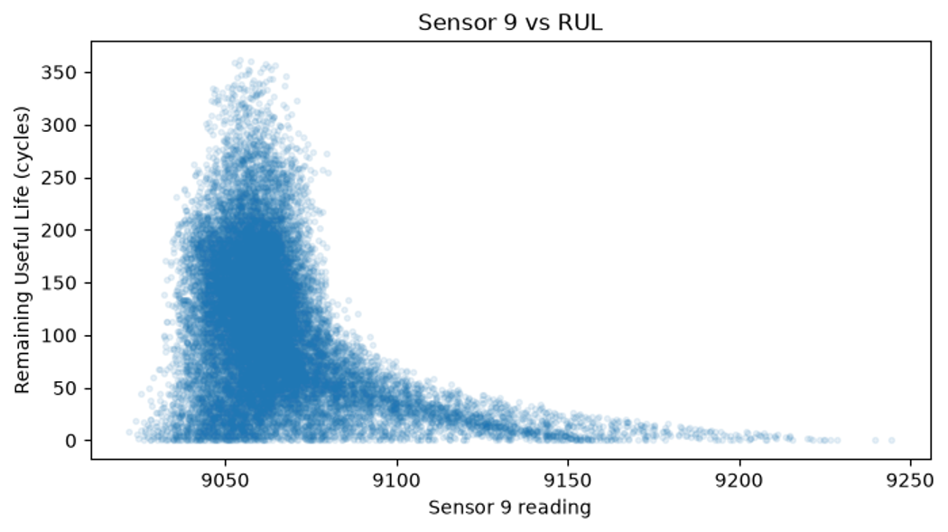
EDA visualizing
7

Slide 10
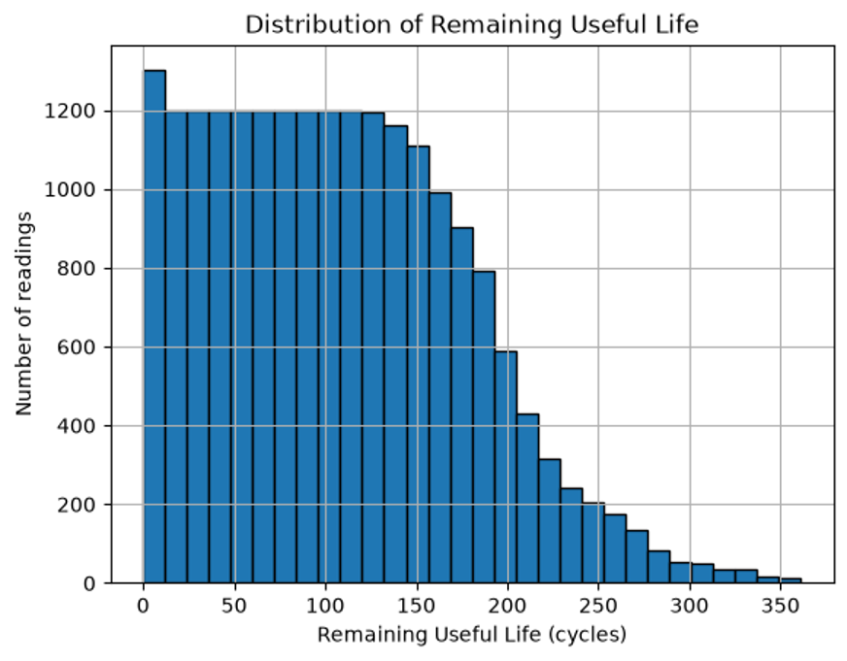
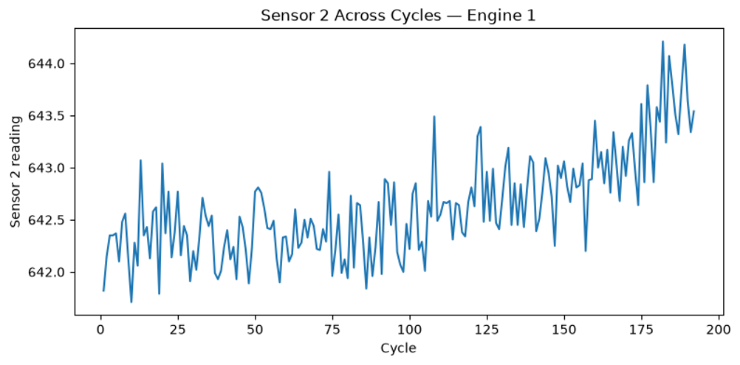
EDA visualizing
7

Slide 11
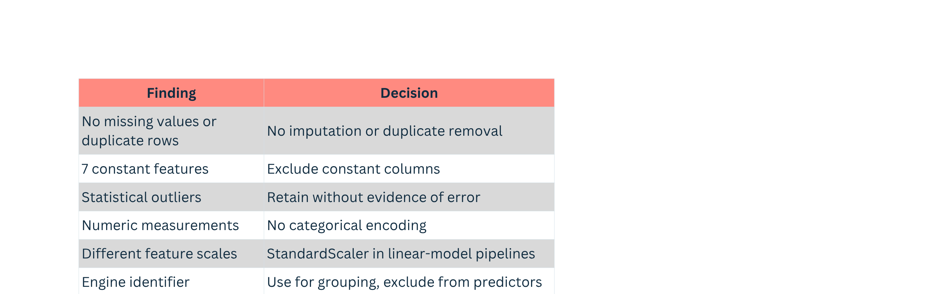

Slide 12
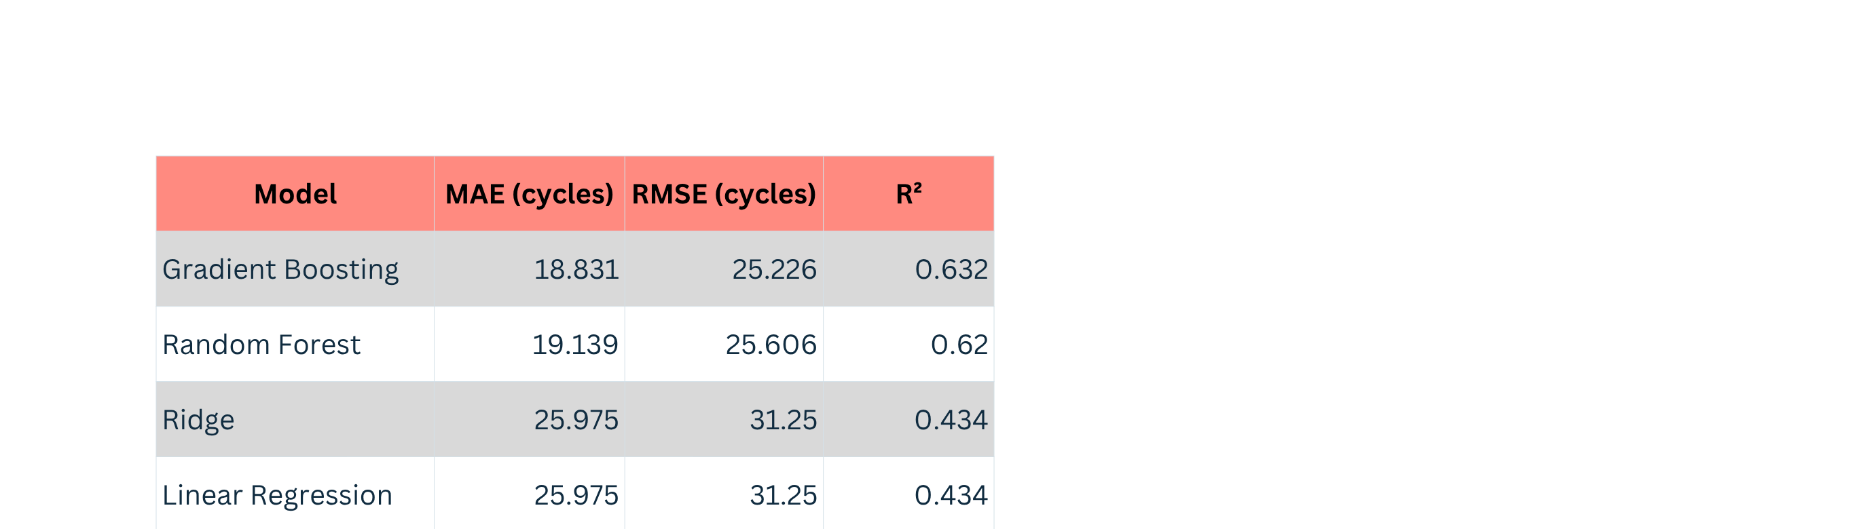
The Models
7
MAE: 18.831 CYCLES AVERAGE ABSOLUTE ERROR

Slide 13
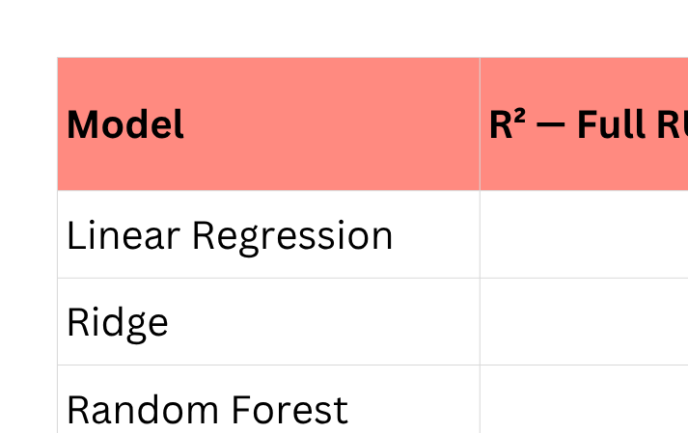
The Models
BOTH EXPERIMENTS USED THE SAME TEST ENGINES. THE FULL-RUL EXPERIMENT USED THE ORIGINAL TARGETS FOR TRAINING AND EVALUATION. THE CAPPED-RUL EXPERIMENT APPLIED A 125-CYCLE CAP TO BOTH.
7

Slide 14
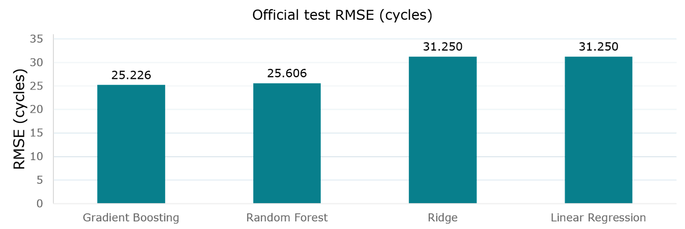
The models
Gradient Boosting reduces test RMSE by 19.3% versus Linear Regression
7

Slide 15
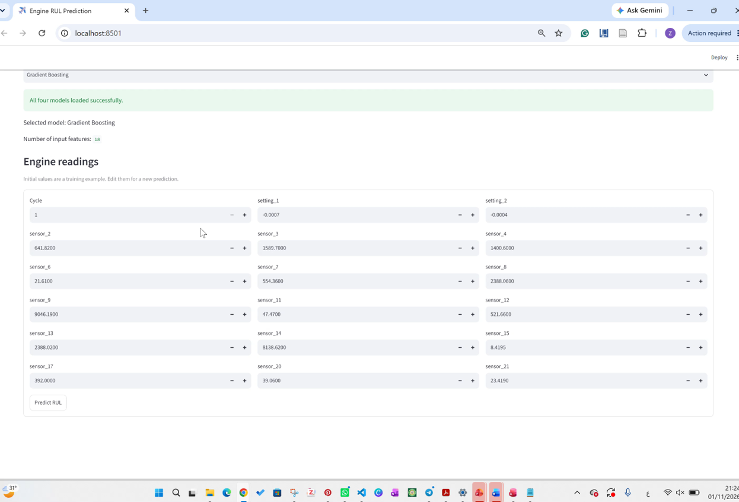
STREAMLIT APP
8

Slide 16
Conclusions
  Built regression models to predict aircraft engine Remaining Useful Life (RUL) from sensor readings and operating settings.
  The project illustrates how RUL predictions could support maintenance planning.
SUBSCRIPTION-BASED LICENSING
LIMITATIONS
FUTURE IMPROVEMENTS
Conclusion: Gradient Boosting achieved MAE 18.831 and RMSE 25.226.
Predictions may not generalize to different engines or operating conditions.
Evaluate the model under broader operating conditions and on data that was not used for model selection or tuning.
10

